Slide 1


JOB ANALYTICS
A
Capstone Project
Presentation on
Presented by Group 1A
Harsha Hari (pd20_111)
Ajaykumar Jogani (pd20_010)
Sanaa Abbasi (pd19_090)
Puneet Pahadia (pd20_085)

Slide 2
What is Instahyre? Instahyre is an online recruitment platform based in India. It connects job seekers with employers and aims to streamline the hiring process. It utilizes a matching algorithm to match job seekers with relevant job opportunities based on their skills, experience, and preferences.

Slide 3
Project analysis slide 2
Contents
Web Scraping by Selenium and Beautifulsoup
Data Interpretation and Visualization by Excel
Instahyre Job Analytics
Data Cleaning and
data manipulation by Python library pandas
Meaningful insights and conclusions with the help of excel and analysis tools
Data Analysis and EDA with NumPy , pandas and SciPy stats
Future Scope

Slide 4
Project analysis slide 4
Methodology
Management Objectives- Time management, communication
Tasks- Web- Scraping, data cleaning, data visualization,meaningful insights
Implementation Plan
- Webscraping, Data collation, data visualization, interpretation, conclusion
Project Objectives-Job Market Trends, Skill Gap Analysis , Recruitment Efficiency, Geographic Insights
Schedules
Customer Objectives- Job Opportunities, Efficient Job Application Process, Access to Quality Employers
-
Resources- python library Selenium,Beautifulsoup pandas , numpy, and excel

Slide 5
Number of Junior Role Is Higher Each City

Slide 6
The maximum number of jobs are in the software & technology.

Slide 7
Number of job opening is highest whose company size is greater than 1000

Slide 8
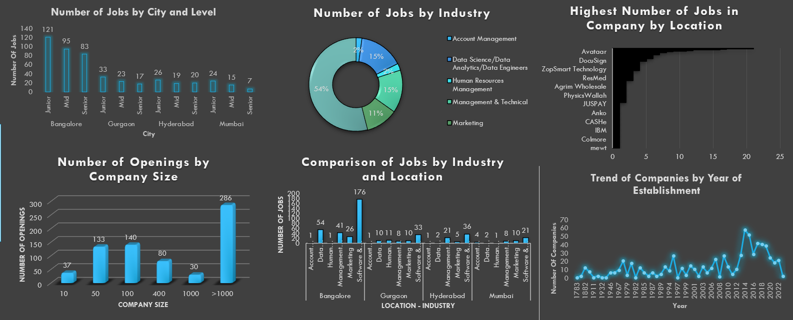
Analytics Dashboard

Slide 9
Project analysis slide 8
SWOT Analysis
POSITIVE
NEGATIVE
STRENGTH
WEAKNESS
Instrahyre is giving jobs opportunity across the India and in different domains.
Instrahyre give jobs preference according to the job seekers skills – set , qualification.
Most of the companies which are looking for employees are situated in Metro- city.
Those people who are not having technical and management skill set have less no of opportunity.
INTERNAL
OPPORTUNITY
THREAT
Instrahyre have to identify the job seekers skills – set and requirements then they can easily Grab the target audience of the market.
There is massive growth in software and technology industry which give large number of employment opportunity.
Jobs market is very volatile and changes with time jobs seekers have to works on holistic development rather then depending on one skill.
EXTERNAL

Slide 10
Project analysis slide 3
CONCLUSION
JOB -MARKET ANALYSIS
COMPANY SIZE ANALYSIS
FINANCIAL ANALYSIS
Geographic Analysis
FUTURE TREND ANALYSIS
The maximum number of jobs are arising in the field of Software and Technical, Data Analysis /Scientists
Companies whose market size is bigger than 1000 have a large number of job openings for different roles and positions.
individuals prioritize high-paying jobs, work satisfaction, and growth in skills as key factors when considering their career choices
The maximum number of jobs in different domains based on location are in Bangalore and other metro-polatian cities
. Masive number of jobs opportunity in Software & technology due to work shifts to IT and technology

Slide 11
Thank You

